Slide 1
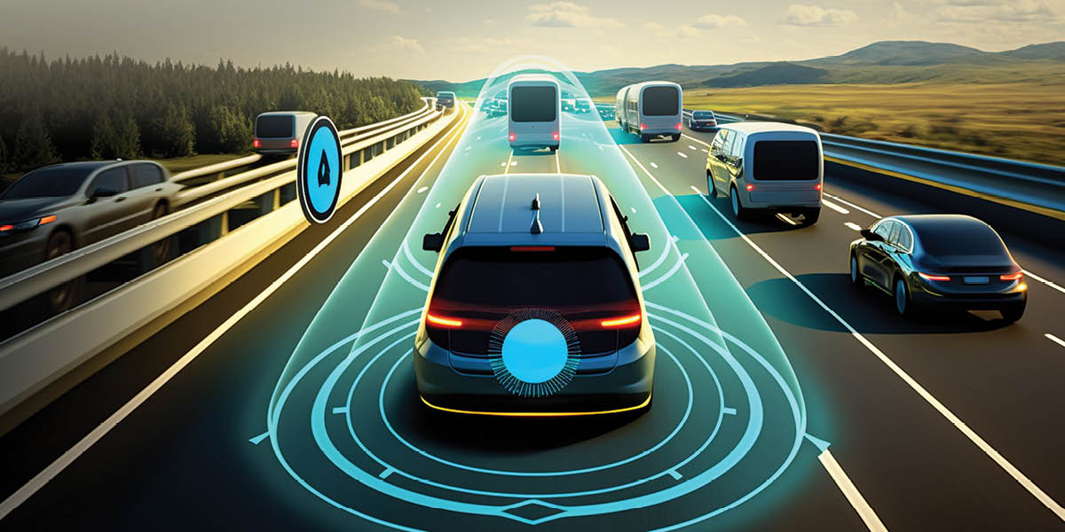
SmartFlow: Integrated Emergency Vehicle Detection and Traffic Rule Monitoring System
Presented By:
Komal S Kallanagoudar
1MS22MC016

Slide 2
Problem Statement
Optimizing Traffic Management for Enhanced Safety and Efficiency

Slide 3
Introduction
SmartFlow aims to create a smarter and safer traffic environment.
The proposed system utilizes the sensor data, to keep traffic flow smooth.
Emergency mode, which gives ambulances priority to pass through traffic.
Traffic Rule Violation Monitoring System.

Slide 4
Objectives
Congestion Control.
Emergency vehicle Detection
Traffic rule violation monitoring system
Navigation Using Li-Fi

Slide 5
Literature survey
Paper Name | Author’s name | Technologies used | Released/Published
Smart Traffic Management System using IoT Enabled Technology | Dr. Vikram Bali, Ms. Sonali Mathur, Dr. Vishnu Sharma, Dev Gaur | RFID technology | 2nd ICACCCN - 2020
IoT-Based Smart Alert System for Drowsy Driver Detection | Anil Kumar Biswal, Debabrata Singh, Binod Kumar Pattanayak, Debabrata Samanta, Ming-Hourb | Machine Learning (ML) and Deep Learning (DL) Algorithms | Published 10 March 2021
Dynamic Traffic Rule Violation Monitoring System Using Automatic Number Plate Recognition with SMS Feedback | R Shreyas, Pradeep Kumar B V, Adithya H B, Padmaja B, Sunil M P | Optical Character Recognition technique, Global System for Mobile Communication | 2nd TEL-NET 2017

Slide 6
Literature survey
Paper Name | Author’s name | Technologies used | Released/Published
Intelligent Traffic Violation Detection | Roopa Ravish, Shanta Rangaswamy, Kausthub Char | YOLOv3 algorithm | 2nd GCAT Bangalore, India. Oct 1-3, 2021.
Smart Healthcare Monitoring System For Healthy Driving in Public Transportation | Pedro Maximino, Rui S. Cruz, Miguel L. Pardal | FPGA-Based Drowsiness Detection System and Eye Recognition System Based on Wavelet Network Algorithm | 2023 18th CISTI
Intelligent Traffic Control System for Smart Ambulance | Prof. Deepali Ahir, Saurabh Bharade, Pradnya Botre, Sayali Nagane, Mihir Shah | GPS Tracking system and Mobile Application | 06-June 2018

Slide 7
Literature survey
Paper Name | Author’s name | Technologies used | Released/Published
Navigation System using Light Fidelity | Niharika Mishra, Riya Mandal, Monika Rai, Harjeet Kaur | Visible light communication | ICOEI 2018 IEEE Conference
IOT Based Automatic Vehicle Accident Alert System | Nazia Parveen, Ashif Ali, Aleem Ali | Accelerometer to detect accident, GPS | 2020 IEEE 5th International Conference
Highway Navigation Using Light Fidelity Technology | Abhishek Patni, Bhavini Mishra, Harsh Aditya, Yogesh Kumar, Rohit Sharma | Light Fidelity | 4, April 2015

Slide 8
Gaps Identified
Dealing with traffic is common among all the papers mentioned.
Using camera module reduce the congestion.
Implementing emergency mode in traffic control.
System detect the vehicle violating the traffic rules.

Slide 9
Implementation
Image Processing
Utilize opencv for image processing task
Capture image using esp-32 cam

Slide 10
Implementation
Vehicle Detection
YOLO object detection model capable of recognizing various types of vehicles
Use this vehicle count data to estimate green delay

Slide 11
Implementation
Emergency Vehicle Detection
Emergency vehicle detection using RFID
Triggering actions such as changing traffic signals or notifying authorities

Slide 12
Results and Discussion
The YOLO algorithm classifies vehicles into categories such as car, truck, or bike
Counting the number of vehicles and estimate the green delay

Slide 13
Results and Discussion
The green delay is updated as per estimation of YOLO algorithm in order to control congestion

Slide 14
Conclusion
The project provides an effective solution for rapid growth of traffic flow
Changing the signal timing intelligently according to traffic density
The emergency vehicle is detected using RFID tag

Slide 15
Scope for Further Enhancement
We can implement the accident detection
Li-fi navigation it help the ambulance driver to take the nearest route to hospital
Implement the traffic rule violation detecting

Slide 16
References
Dr. Vikram Bali, Ms. Sonali Mathur, Dr. Vishnu Sharma, Dev Gaur researched on Smart Traffic Management System using IoT Enabled Technology, 2020 2nd International Conference on Advances in Computing, Communication Control and Networking (ICACCCN). https://ieeexplore.ieee.org/document/9362753
Anil Kumar Biswal, Debabrata Singh, Binod Kumar Pattanayak, Debabrata Samanta and Ming-Hourb Yang worked on IoT-Based Smart Alert System for Drowsy Driver Detection ( Received 29 December 2020; Revised 18 January 2021; Accepted 10 February 2021; Published 10 March 2021). https://www.hindawi.com/journals/wcmc/2021/6627217/
Shubham Kumar Chandravanshi1 , Hirva Bhagat2 , Manan Darji3 , Himani Trivedi worked on Automated Generation of Challan on Violation of Traffic Rules using Machine Learning paper released by International Journal of Science and Research (IJSR) in 2019. https://www.ijsr.net/archive/v10i3/SR21222190144.pdf
R Shreyas, Pradeep Kumar B V, Adithya H B, Padmaja B, Sunil M P worked on Dynamic Traffic Rule Violation Monitoring System Using Automatic Number Plate Recognition with SMS Feedback paper released on 2017 2nd International Conference on Telecommunication and Networks (TEL-NET 2017). https://ieeexplore.ieee.org/document/8343528

Slide 17
References
Roopa Ravish, Shanta Rangaswamy, Kausthub Char worked on Intelligent Traffic Violation Detection paper released on 2021 2nd Global Conference for Advancement in Technology (GCAT) Bangalore, India. Oct 1-3, 2021. https://ieeexplore.ieee.org/document/9587520
Niharika Mishra, Riya Mandal, Monika Rai, Harjeet Kaur worked on Navigation System using Light Fidelity Proceedings of the 2nd International Conference on Trends in Electronics and Informatics (ICOEI 2018) IEEE Conference. https://ieeexplore.ieee.org/document/8553760
Pedro Maximino, Rui S. Cruz, Miguel L. Pardal worked on Smart Healthcare Monitoring System For Healthy Driving in Public Transportation published paper in 2023 18th Iberian Conference on Information system and Technologies (CSISTI) 20-23 June 2023. https://ieeexplore.ieee.org/document/10211847
Prof. Deepali Ahir, Saurabh Bharade, Pradnya Botre, Sayali Nagane, Mihir Shah worked on Intelligent Traffic Control System for Smart Ambulance paper released in International Research Journal of Engineering and Technology (IRJET) Volume: 05 Issue: 06 June-2018. https://www.irjet.net/archives/V5/i6/IRJET-V5I675.pdf

Slide 18
References
Meghana V, Prof. Anisha B S, Dr Ramakanth Kumar P worked on IOT based Smart Traffic Signal Violation Monitoring System using Edge Computing paper released on 2021 2nd Global Conference for Advancement in Technology (GCAT) Bangalore, India. Oct 1-3, 2021. https://ieeexplore.ieee.org/document/9587585
Nazia Parveen, Ashif Ali, Aleem Ali worked on IOT Based Automatic Vehicle Accident Alert System paper released in 2020 IEEE 5th International Conference on Computing Communication and Automation (ICCCA) Galgotias University, Greater Noida, UP, India. Oct 30-31, 2020. https://ieeexplore.ieee.org/document/9250904
X.S. Asha Shiny, D.Ravikumar, A. Chinnasamy, S. Hemavathi worked on Cloud Computing based Smart Traffic Management System with Priority Switching for Health Care Services paper released by Proceedings of the Second International Conference on Applied Artificial Intelligence and Computing (ICAAIC 2023) IEEE Xplore. https://ieeexplore.ieee.org/document/10140942
Abhishek Patni, Bhavini Mishra, Harsh Aditya, Yogesh Kumar, Rohit Sharma worked on Highway Navigation Using Light Fidelity Technology paper released by IJISET - International Journal of Innovative Science, Engineering & Technology, Vol. 2 Issue 4, April 2015. https://ijiset.com/vol2/v2s4/IJISET_V2_I4_209.pdf
Sarfraz Fayaz Khan researched on Health Care Monitoring System in Internet of Things (loT) by Using RFID paper released in 2017 the 6th International Conference on Industrial Technology and Management. https://ieeexplore.ieee.org/document/7917920

Slide 19
Thank You…..

